Slide 2

SECRET Way to Use Top AI APIs for FREE (DeepSeek-R1 now included!) - 00:18:000

Slide 3

SECRET Way to Use Top AI APIs for FREE (DeepSeek-R1 now included!) - 00:20:000

Slide 4
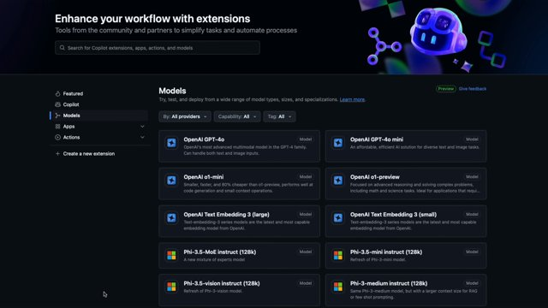
SECRET Way to Use Top AI APIs for FREE (DeepSeek-R1 now included!) - 00:23:000

Slide 5
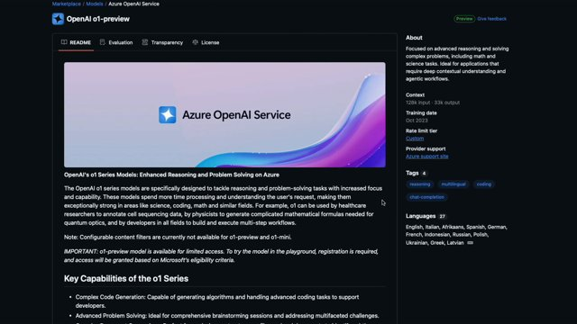
SECRET Way to Use Top AI APIs for FREE (DeepSeek-R1 now included!) - 00:39:000

Slide 6
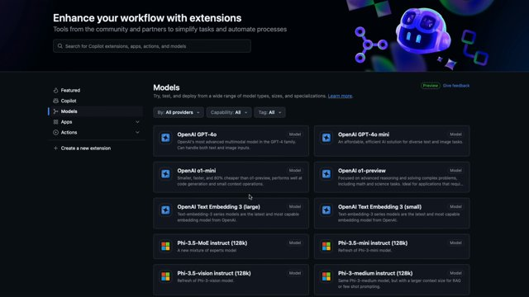
SECRET Way to Use Top AI APIs for FREE (DeepSeek-R1 now included!) - 00:43:000

Slide 7
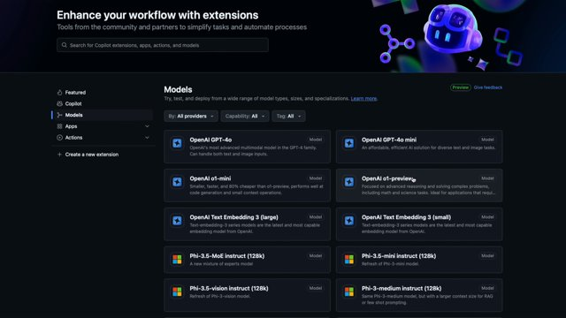
SECRET Way to Use Top AI APIs for FREE (DeepSeek-R1 now included!) - 00:45:000

Slide 8
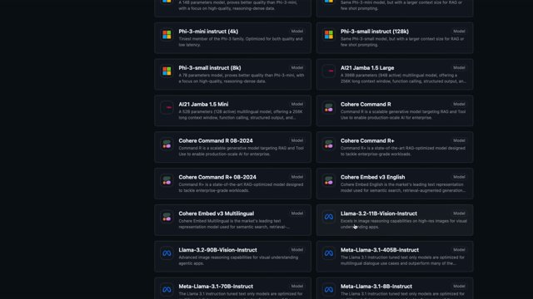
SECRET Way to Use Top AI APIs for FREE (DeepSeek-R1 now included!) - 00:46:000

Slide 9
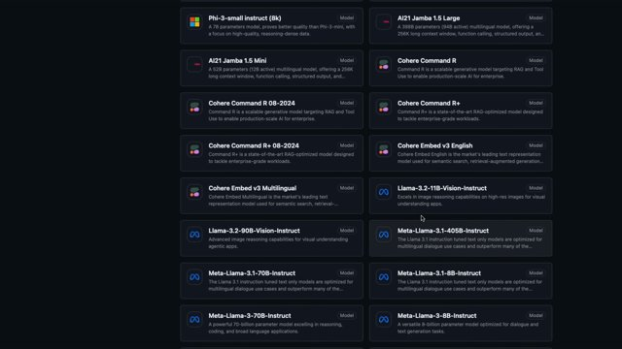
SECRET Way to Use Top AI APIs for FREE (DeepSeek-R1 now included!) - 00:47:000

Slide 10
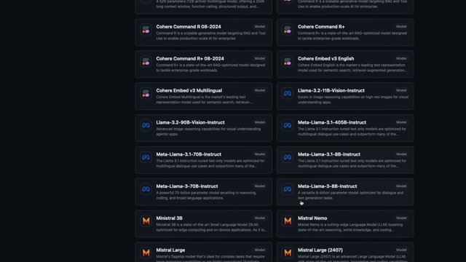
SECRET Way to Use Top AI APIs for FREE (DeepSeek-R1 now included!) - 00:48:000

Slide 11
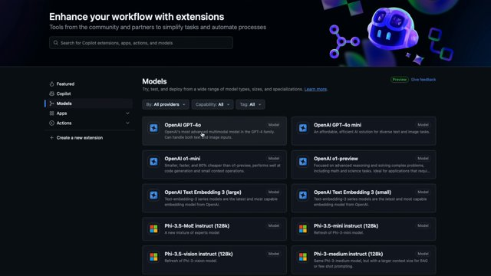
SECRET Way to Use Top AI APIs for FREE (DeepSeek-R1 now included!) - 00:50:000

Slide 12
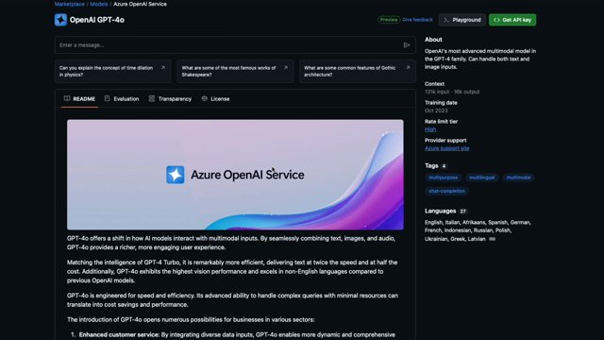
SECRET Way to Use Top AI APIs for FREE (DeepSeek-R1 now included!) - 00:53:000

Slide 13
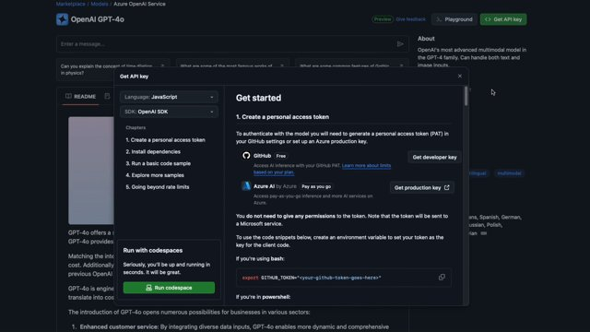
SECRET Way to Use Top AI APIs for FREE (DeepSeek-R1 now included!) - 00:55:000

Slide 14
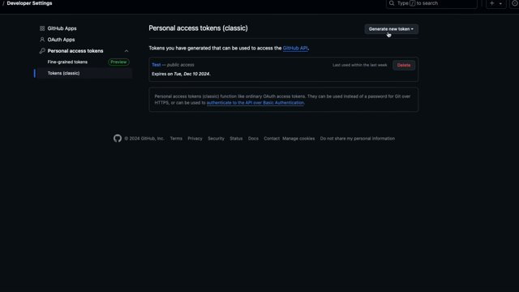
SECRET Way to Use Top AI APIs for FREE (DeepSeek-R1 now included!) - 00:58:000

Slide 15
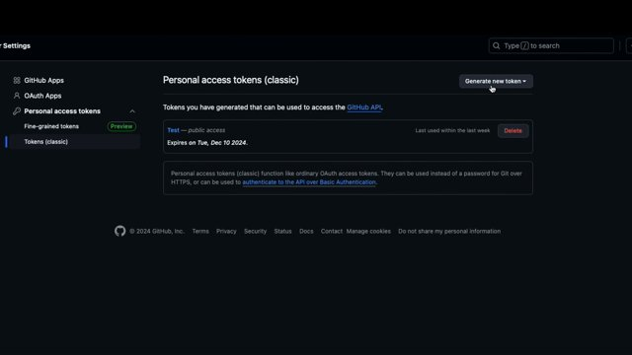
SECRET Way to Use Top AI APIs for FREE (DeepSeek-R1 now included!) - 00:59:000

Slide 16
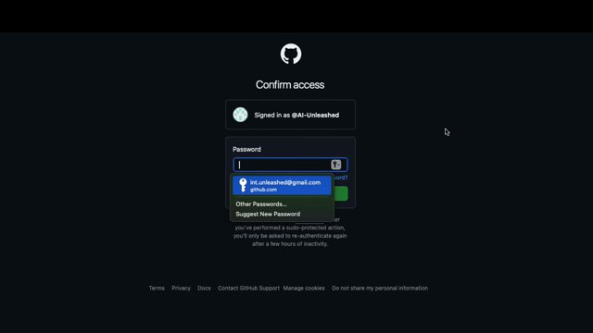
SECRET Way to Use Top AI APIs for FREE (DeepSeek-R1 now included!) - 01:03:000

Slide 17
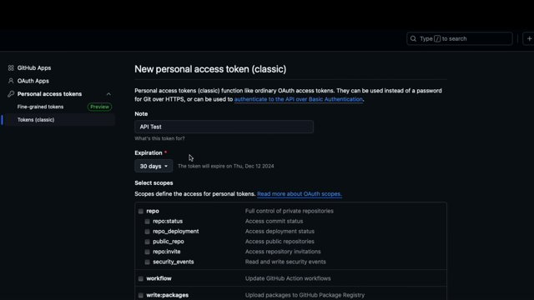
SECRET Way to Use Top AI APIs for FREE (DeepSeek-R1 now included!) - 01:04:000

Slide 18
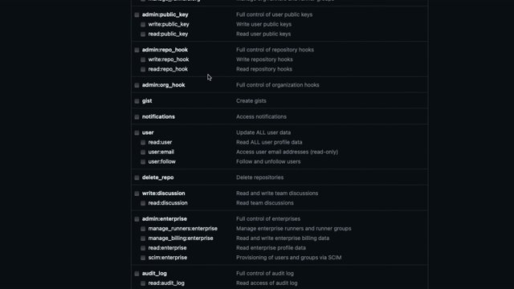
SECRET Way to Use Top AI APIs for FREE (DeepSeek-R1 now included!) - 01:09:000

Slide 19
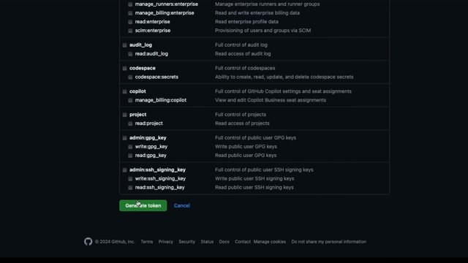
SECRET Way to Use Top AI APIs for FREE (DeepSeek-R1 now included!) - 01:10:000

Slide 20
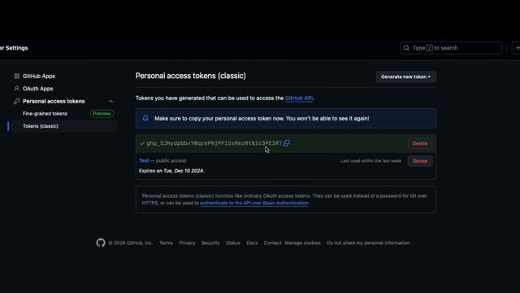
SECRET Way to Use Top AI APIs for FREE (DeepSeek-R1 now included!) - 01:12:000

Slide 21
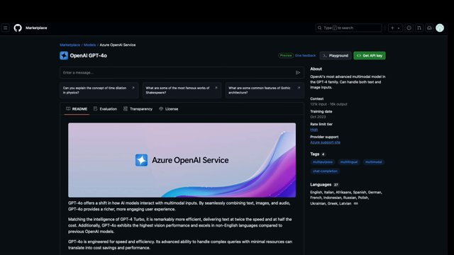
SECRET Way to Use Top AI APIs for FREE (DeepSeek-R1 now included!) - 01:19:000

Slide 22
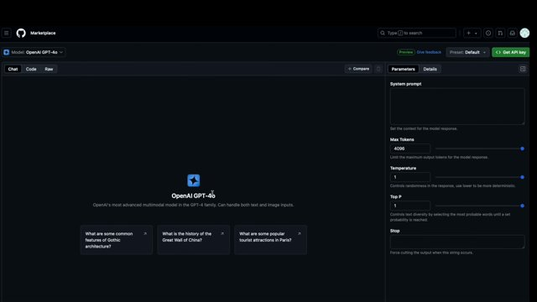
SECRET Way to Use Top AI APIs for FREE (DeepSeek-R1 now included!) - 01:28:000

Slide 23
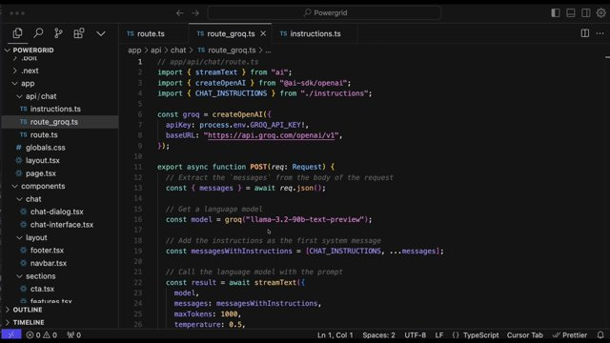
SECRET Way to Use Top AI APIs for FREE (DeepSeek-R1 now included!) - 02:13:000

Slide 24
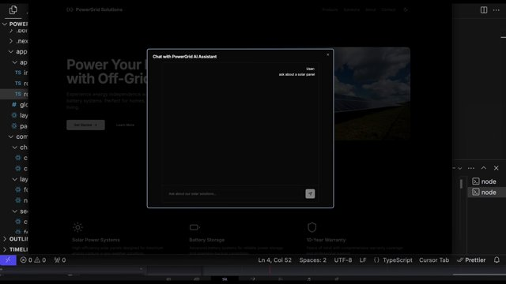
SECRET Way to Use Top AI APIs for FREE (DeepSeek-R1 now included!) - 02:59:000

Slide 26
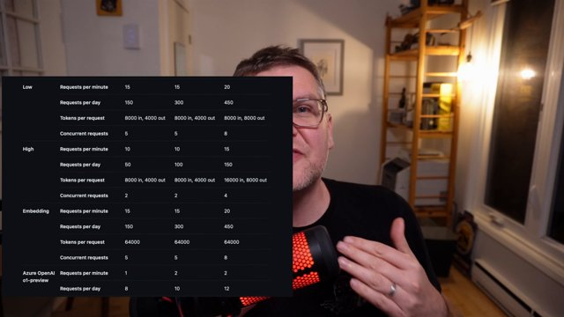
SECRET Way to Use Top AI APIs for FREE (DeepSeek-R1 now included!) - 03:20:000

Slide 27
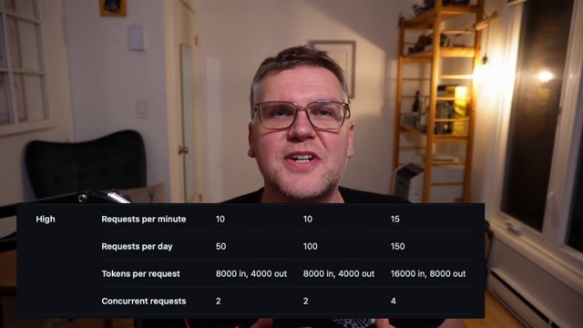
SECRET Way to Use Top AI APIs for FREE (DeepSeek-R1 now included!) - 03:21:000

Slide 28
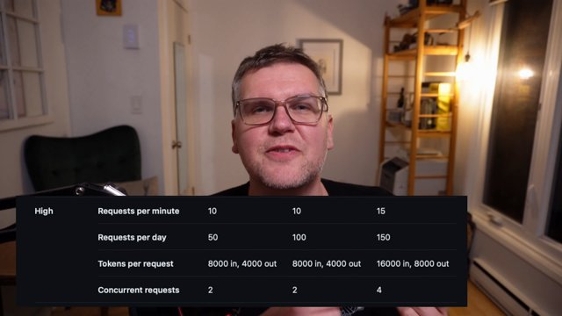
SECRET Way to Use Top AI APIs for FREE (DeepSeek-R1 now included!) - 03:22:000

Slide 29
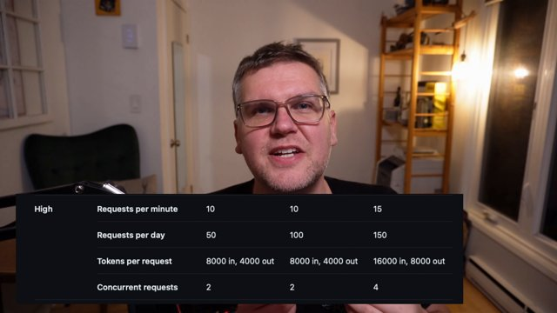
SECRET Way to Use Top AI APIs for FREE (DeepSeek-R1 now included!) - 03:24:000

Slide 30
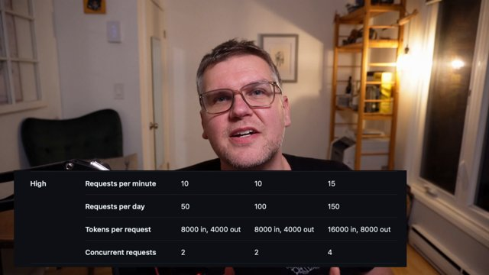
SECRET Way to Use Top AI APIs for FREE (DeepSeek-R1 now included!) - 03:26:000

Slide 31
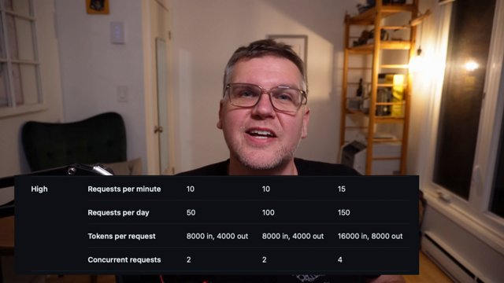
SECRET Way to Use Top AI APIs for FREE (DeepSeek-R1 now included!) - 03:28:000

Slide 32


